Slide 1
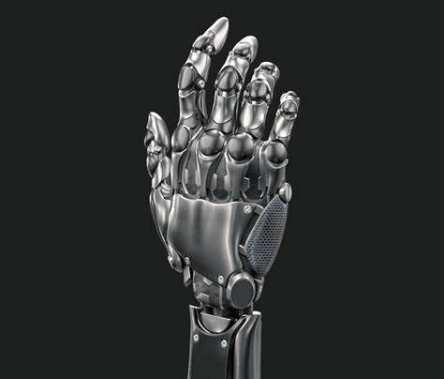
Robotic Finger
Mechatronics Final Project

Slide 2
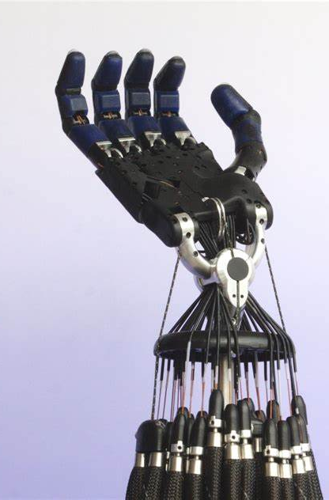
1. Abstract 2. Introduction 3. Robotic Finger 4. Conclusion and Future work

Slide 3
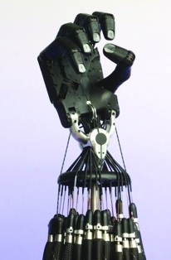
1. Abstract This project’s goal is to build a robotic finger which tracks the motion of a human finger. In the following parts we are going to discuss different parts of this project namely: 1. 3D-printing of the designed parts in SOLIDWORKS 2. applying robot vision using mediapipe 3. coding Arduino and building the ultimate

Slide 4
2. Introduction This research can be accounted as the base of mind-controlled artificial limbs projects and also humanoid robots.

Slide 5
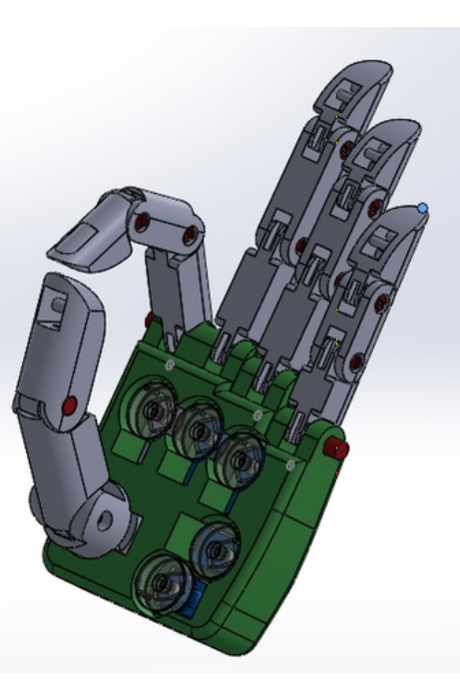
3. Robotic finger 3-1. 3D-printing In this part we use the STL files of a previous project in the same field. Because we only need the index finger we only printed that finger.

Slide 6
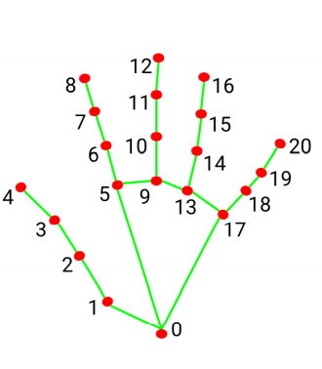
3. Robotic finger 3-2. Robot Vision for the sake of robot vision we use mediapipe library from python. This system employs machine learning to infer 21 landmarks of the hand.

Slide 7
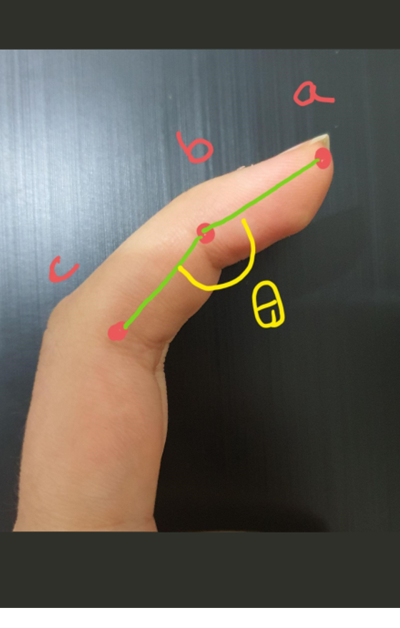

3. Robotic finger 3-2. Robot Vision First we need to calculate each joint’s angel. In this regard, we use the following formula. which a, b, and c are the detected landmarks obtained from the system .

Slide 8
3. Robotic finger 3-2. Robot Vision As we mentioned before our project’s goal is to show 10 different postures of a finger. Thus when we capture each joint’s angle, we must decide which posture should our artificial finger take

Slide 9
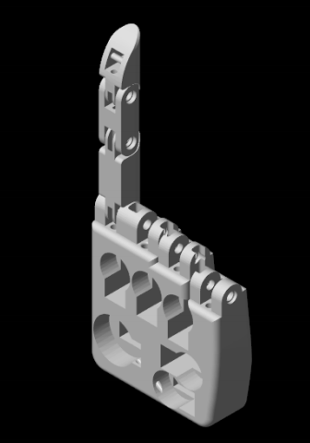
3. Robotic finger 3-3. Matlab simulation In this part we use matlab Simulink to represent the appearances and functionality of the model. Using the input signal which is a number between 0 to 9, we can specify the joints position. In order to check that our model is working properly, we write the position of the real finger in each time in a CSV file and also write the position of the simulated hand in a another CSV file, then compare these files together.

Slide 10
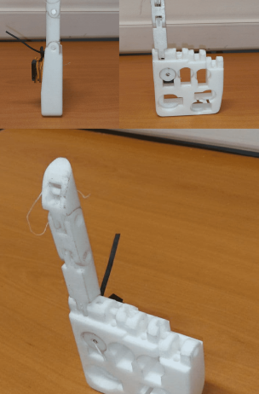
3. Robotic finger 3-4. Building The Robot In this part we first concatenate 3D-printed parts with a servo motor and a pulley and 3 pins. Then with the position number obtained from mediapipe, the servo motor rotate properly. We should mention that the equilibrium position for the finger is the pointing position and each time with the use of a elastic string it goes to the pointing position.

Slide 11
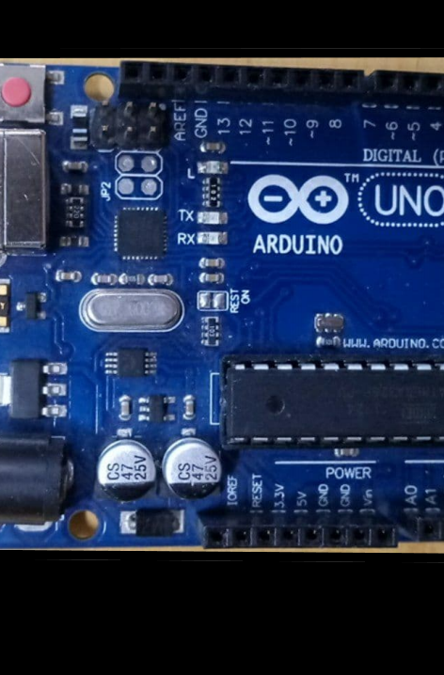
3. Robotic finger 3-5. Arduino Coding this part do two major tasks: 1. Sending commands to the servo motor and moving the robot 2. Providing a connection between python code and the robot using the serial port (serial window in Arduino).

Slide 12
4. Conclusion and Future work After testing our robot several times we conclude that it works properly. For or future work, we can build the whole hand and apply this project for all fingers. This robotic hand can be use in a wide range of a robotic structures. In order to improve our work, we can use several motors so that we can illustrate the exact hand position.

Slide 13
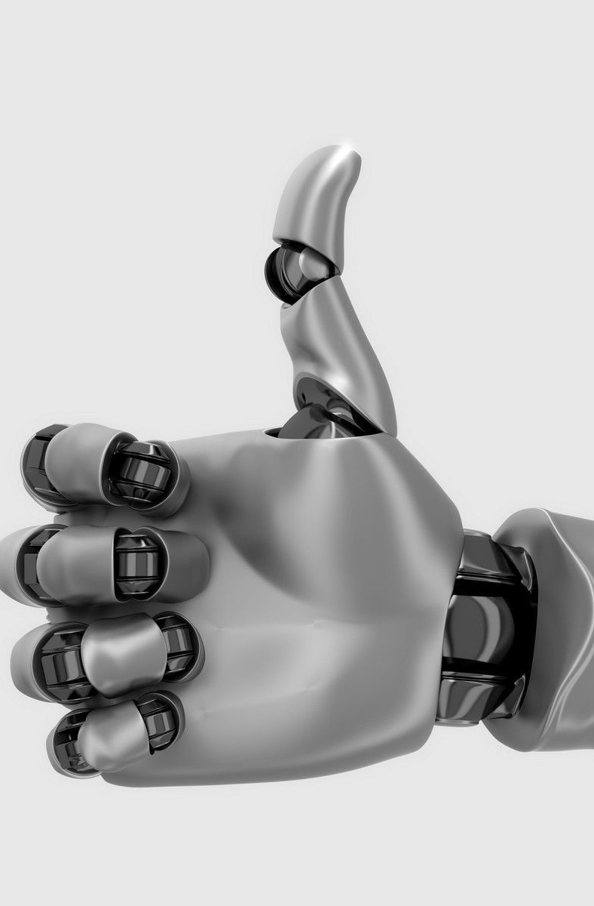
Thank You
Farnoush Baghestani (810196422)
Setareh Soltanieh (810196640)
Behnam Moradkhani (810196559)
Niusha Mirhakimi (810196569)
Erfan Vahabi (810196677)

